Slide 1
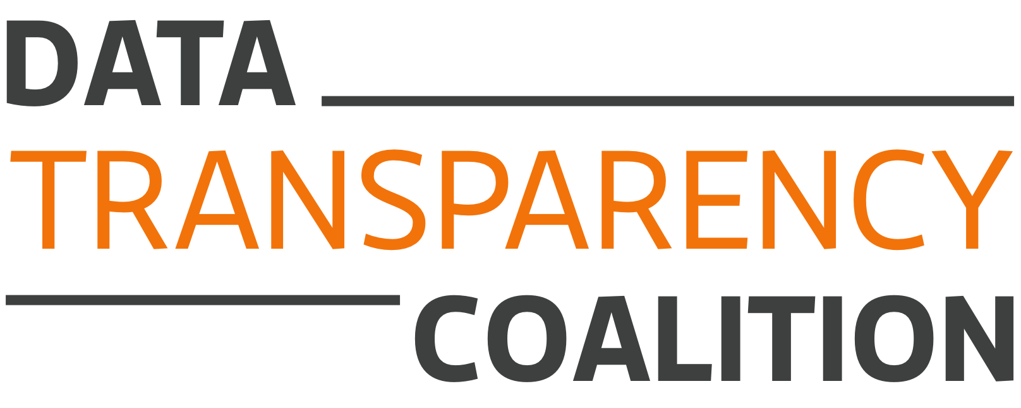
Open Data Industry Perspective
September 26, 2014
Data Transparency Town Hall

Slide 2
Industry
“One of the things we’re doing to fuel more private sector innovation and discovery is to make vast amounts of America’s data open and easy to access for the first time in history. And talented entrepreneurs are doing some pretty amazing things with it.
“Starting today, we’re making even more government data available online, which will help launch even more new startups. And we’re making it easier for people to find the data and use it, so that entrepreneurs can build products and services we haven’t even imagined yet.”
President Barack Obama, May 9, 2013

Slide 3
Coalition
Members. Executive Members Teradata, Workiva, PwC, RDG Filings, RR Donnelley; 17 Regular Members; 4 Startup Members.
Advocacy. We advocate on behalf of the private sector and the public interest for the publication of government information as standardized, machine-readable data.
Education. We educate government leaders, private-sector innovators, and the public on the benefits of open data.
Collaboration. Our events bring together federal leaders working to transform government information from disconnected documents into open data with those seeking to find the data and use it.

Slide 4
Benefits
Public Accountability. Open data would allow citizens to access accurate, complete, searchable data on government spending. Serendipitous data reuse.
Federal Management. Government-wide data standards for spending would lower the costs of dashboards and analytics for Congress, Treasury, OMB, agency leaders, inspectors general, and program managers.
Automated Compliance. Government-wide data standards for spending would allow grantees and contractors to automate their compliance burdens.

Slide 5
Steps
Standardize. Establish and implement government-wide data standards, including common identifiers and common data exchange formats.
Publish. Following the Open Data Policy and established best practices, publish all federal spending information, subject to well-defined exceptions.

Slide 6
Standards
Complete. Cover the whole structure of federal spending—not just what’s to be published.
Incremental. Match existing reports and structures before building new ones.
Accepted. Favor XML and XBRL; the Legal Entity Identifier (LEI), Content Standard for Digital Geospatial Metadata (CSGDM), and other existing voluntary consensus standards.
Non-Proprietary. Avoid standards with restrictions that impede the free reuse of federal spending data.
Enforced. Consider the counter-example of the SEC.
Sustainable. Established standards with frequent, structured, and public stakeholder input, and consider non-federal governance models.

Slide 7
Publication
For the Public. USASpending.gov should offer both bulk download and user-friendly navigation.
For Inspectors General. The Recovery Operations Center provides a model for government-wide antifraud analytics.
For Agency Management. Agency financial officers should be find new functionality through internal publication.
For Treasury and OMB. Enterprise-wide federal financial management should benefit from new views and navigation.
For Congress. Congress should develop tools connecting allocation and appropriations decisions with results.

Slide 8
Implementation
Agencies
  Required by law: Report financial, payment, budget, grant, and contract information subject to DATA Act standards.
  Not required by law: Implement DATA Act standards throughout underlying systems.
Recipients
  2015-2017: OMB pilot illuminates potential of data standards to consolidate and automate existing recipient reporting requirements.
  2017 and later: OMB expands the use of data standards to cover all federal grant and contract reporting, following GATB roadmap.

Slide 9
Future
Map Internal and External Spending. Geospatial standards will allow an automatic CFFR.
Resolve Entities and Hierarchies. Divisions and subdivisions of agencies and recipients should be consistently tracked and identified.
Match Recipients, Awards, Payments, and Programs. These fields all reach across multiple reporting regimes.
Track the Life Cycle. Allow users to follow dollars through appropriation, apportionment, allotment, commitment, award, obligation, payment, and subaward.
Encourage Reuse of the Standards. DATA Act identifiers and exchange formats could improve reporting regimes beyond the DATA Act, such as Single Audit Act reporting by federal grantees.

Slide 10
Contact
datacoalition.org
hudson.hollister@datacoalition.org
@datacoalition

